Slide 1

Jaypee University of Information Technology, Waknaghat – 173234 (India)
Minor Project (18B19CI691) P2 Presentation | AY 2023-24
Violence Detection System
using Deep Learning
Supervisor
Name: Prof. Dr. Vivek Kumar Sehgal
Designation: Professor and Head
Department: Department of Computer Science & Engineering and Information Technology
Group No.: 60
Team Member (s)
Aayush Sharma (211193)
Aadya Thakur (211184)

Slide 2

Outline
Introduction
Literature Review
Problem Statement
Objectives
System Design
Architecture Diagram
Use Case Diagram
Methodology
1st Phase(Model Training)
Program Code
Output of Phase 1

Slide 3
Outline (cont…)
2nd Phase(Alert System)
Program Code
Output of Phase 2
3rd Phase(Image Enhancement and Face Detection)
Program Code
Output of Phase 3
Results
Conclusion
Future Scope
Work Contribution of Each Member
References

Slide 4
Introduction
Violent behavior in public places is an issue that has to be addressed. Communities
are also eroded by violence, which reduces productivity, lowers property values, and
disrupts social services. Across the world, violence is a severe public health issue. It
affects people at various phases of life, from infants to the elderly.
Recognizing violence is challenging since it must be done on real-time videos
captured by a large number of surveillance cameras at any time and in any location.
It should be able to make reliable real-time detection and alert corresponding
authorities as soon as violent activities occur.
Public video surveillance systems globally provide extensive data for security, yet
manual review hampers decision-making efficiency. Automatic violence detection
in videos has emerged to alleviate prolonged scrutiny, leveraging deep learning,
notably MobileNetv2, for accurate identification. Recent studies emphasize
deep learning's prowess in extracting spatiotemporal features, vital for pinpointing
violent scenes. These methods excel in capturing spatial and motion information,
enabling real-time violence alert systems.

Slide 5
Literature Review
Recently proposed methods for violence detection can be roughly classified into three
categories visual based approach, audio-based approach and hybrid approach
Visual Based Approach: Visual information is retrieved and represented as relevant features in this approach. Local features and global features are two types of features. Position, velocity, form, and color are examples of local features, while average
speed, region occupancy, relative positional fluctuations, and the interactions between
objects and backdrop are examples of global features.
Audio Based Approach : Audio data is used to classify violence in this approach.
It uses a hierarchical technique based on Gaussian mixture models and Hidden Markov
models to distinguish gunshots, explosions, and automobile braking in audio.
Hybrid Approach : The emphasis in the hybrid method is on merging visual and
audio characteristics. Some techniques recognize violent incidents in videos utilizing flame and blood detection and recording the degree of motion, as well as the typical sounds of violent occurrences. The CASSANDRA system [7], detects aggression
in surveillance videos using motion features associated with articulation in video.

Slide 6
Literature Review (cont…)
S. Paper Title No. [Cite] |  | Journal/ Conference (Year) | Accuracy/Dataset used | Results | Limitations
1. | Efficient Spatio-Temporal Modeling Methods for Real-Time Violence Recognition [1] | IEEE Access, vol. 9. 2023 | Hockey dataset - 99.3% Movies dataset - 100% | This approach integrates three modules: Motion Saliency Map (MSM), 2D CNNs with frame-grouping, and Temporal Squeeze and Excitation Block. MSM identifies moving objects by emphasizing regions associated with violence in videos via dilation of motion boundaries. 2D CNNs convert each three-channel frame into a single-channel frame for spatio-temporal representation through frame-grouping. The Temporal Squeeze and Excitation Module optimizes classification of target events with reduced computational overhead. | This approach cannot be used in moving cameras as a sequence of frames in a fixed position is necessary to recognize violence. The computational cost of this approach is high as it requires lots of calculations using 3 different modules with a predefined set of tasks.

Slide 7
Literature Review (cont…)
S. Paper Title No. [Cite] |  | Journal/ Conference (Year) | Authors | Results | Limitations
2. | Space-time interest points [2] | Ninth IEEE International Conference on Computer Vision 2003 | Football dataset - 100% | STIP analysis detects interest points by assessing spatial and temporal differences, extracting 3D volumes around each point to depict temporal evolution. These points exhibit significant intensity variation in space and non-constant motion in time across various scales. Appearance in the 3D cube is identified using Histogram of Oriented Gradients (HOG), while motion is defined by Histogram of Oriented Flows (HOF). This approach ensures accurate recognition of motion events resistant to scale, frequency, and velocity changes. | Despite promising results with a high accuracy rate for this task, the computational cost of extracting such features is extremely high for practical applications, such as surveillance and media rating systems.

Slide 8
Literature Review (cont…)
S. Paper Title No. [Cite] |  | Journal/ Conference (Year) | Authors | Results | Limitations
3. | Violence detection in surveillance video using low-level features. [3] | PLoS ONE 2018 | Hockey dataset - 94.6% BEHAVE dataset - 100% Crowd Violence Dataset - 94.3% | The motion region is segmented based on the optical flow field distribution. Low-level traits expressing appearance and dynamics of aggressive behavior are extracted in the motion domain, including LHOG from RGB images and LHOF from optical flow images. Features are encoded using a Bag of Words model to standardize vector lengths. Classification is performed using a Support Vector Machine on the encoded video layer vectors, ensuring efficient removal of redundant information. Finally, we use a support vector machine to classify the video layer vectors. | This process is really computationally expensive and depends on a lot of parameters, hence is not suitable for real-time environments and for daily use..

Slide 9
Literature Review (cont…)
S. Paper Title No. [Cite] |  | Journal/ Conference (Year) | Authors | Results | Limitations
4. | Violence Detection Using Spatiotemporal Features with 3D Convolutional Neural Network. [4] | Sensors 19 2019 | Violent Crowd - 98% Violence in Movies - 99.9% Hockey Fight - 96% | A triple staged end-to-end deep learning violence detection framework is proposed. Lightweight CNN models are used to detect individuals in surveillance video streams, reducing processing of unusable frames. Detected individuals are then passed through a 3D CNN to extract spatiotemporal features, which are fed into a Softmax classifier. The 3D CNN model is optimized using a neural networks optimization toolkit and Intel's open visual inference. The trained model is converted into an intermediate illustration for execution on the end platform, enabling final detection of violence. | Detection of violence in a crowded scene was a challenge due to the serious occlusion and moving crowd. It has low detection rate and high false alarm.

Slide 10
Literature Review (cont…)
S. Paper Title No. [Cite] |  | Journal/ Conference (Year) | Authors | Results | Limitations
5. | Real-Time Violence Detection Using CNN [5] | Springer 2022 | Hockey Dataset : With MobileNet 96% With GoogleNet 94.9% | This study presents a violence detection system based solely on CNNs. CNN models directly process surveillance videos to identify violent behavior patterns. Through rigorous training, the CNN system achieves high accuracy in detecting violence across diverse datasets. Its simplicity and efficiency make it suitable for real-world deployment. The CNN-based approach shows promise for scalable implementation in various surveillance contexts. Overall, this research highlights the effectiveness of CNNs in violence detection tasks. | The disadvantage of using just CNN is that, it requires a lot of time for computation and is less accurate

Slide 11
Literature Review (cont…)
S. Paper Title No. [Cite] |  | Journal/ Conference (Year) | Authors | Results | Limitations
6. | A Sensor Network Approach for Violence Detection in Smart Cities Using Deep Learning. [6] | Sensors (Basel) 2019 | BEHAVE dataset - 87.17% | Deep neural network images are extracted from an MPEG encoded video input stream. Then the DNN is trained to recognise frames which correspond to violent behavior. | Similar to other methods, lots of computational power is required which is not suitable for real -time usage / environments or for daily usage

Slide 12
Problem Statement
⬡ CCTV Surveillance is used to a greater extent but still it lacks the feature of automatic violence detection
⬡ Manual monitoring is not a feasible task and the time taken to respond
to the situation is also crucial
⬡ A Real-Time violence alert system is proposed which can notify the concerned authorities with the required details in real-time.

Slide 13
Objectives
The objective is to develop a real-time surveillance system capable of detecting violent activities in video footage captured by surveillance cameras.
The methodology utilizes deep learning techniques, particularly the MobileNet v2 model, to automatically identify instances of violence in video streams.
The alert system is also to be integrated along with the pretrained model which will send an alert message to the concerned authorities whenever violence is detected in the video frames .The alert message must include the date ,time and location of the violence activity. The optional feature is that the enhanced faces of the people involved in the activity is also send in violence alert.

Slide 14
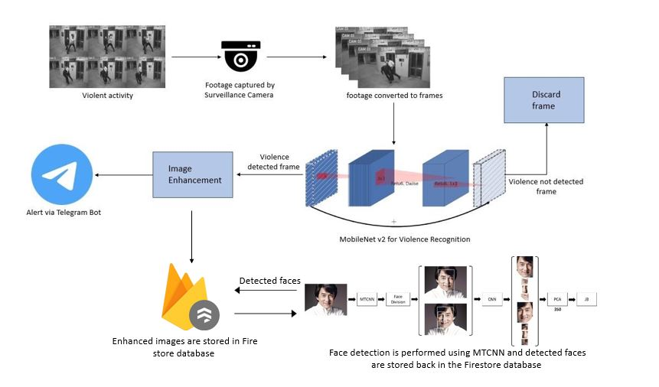
System Design
Footage from the surveillance camera is broken down into frames. The frames are given as input to MobileNet v2 classifier for detecting violent activities in the given sequence of input frames. If no violent activity is recognized the respective frames are discarded. The violence detected frame is obtained and it is enhanced for better clarity. That frame, along with the location are sent to the nearest authorities using Telegram bot.

Slide 15





Architecture Diagram
Video frames
Surveillance camera
Image Enhancement
Alert System
Discard frames
Use of MobileNet
Use of Python Imaging Library(PIL)
YES
Obtain the violence recognized frame
NO
Violence Recognition
YES
Figure 1 : Architecture Diagram

Slide 16






Use Case Diagram
Real time Violence detection system
Feed Real time video
Detect humans
include
Extract frames
include
Violence detection
People involved in a violent activity
6
Concerned Authority
include
Image Enhancement
Alert System
Figure 2 : Use Case Diagram

Slide 17
Methodology
⬡ A dataset having 1000 videos each of violence category and non-violence
category was chosen
⬡ A model was trained using MobileNetV2 using the dataset
⬡ Real-time video footage is given as input
⬡ Output is obtained as image frames

Slide 18
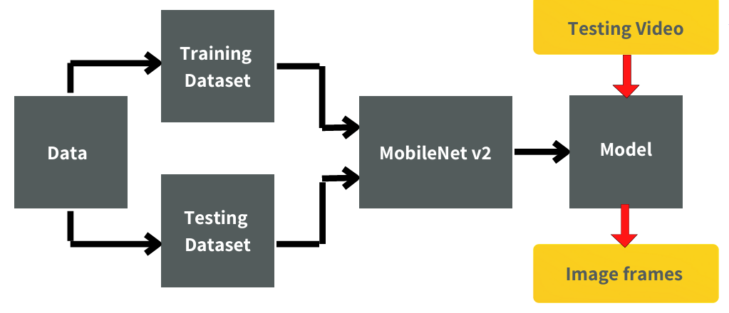
1st Phase(Model Training)
Figure 3 : Methodology of Model Training

Slide 19
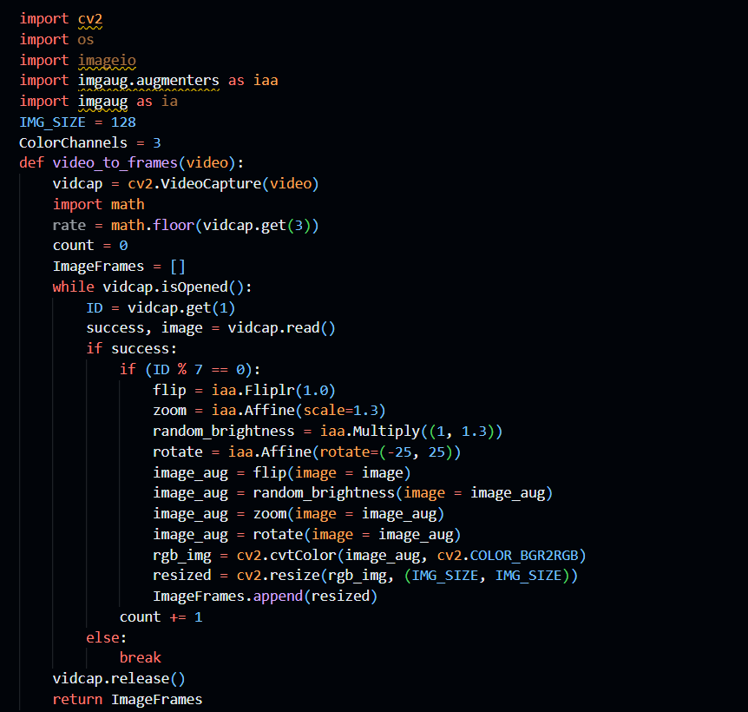
Program code
Figure 2 : Use Case Diagram
Figure 4 : Code snippet for Preprocessing

Slide 20
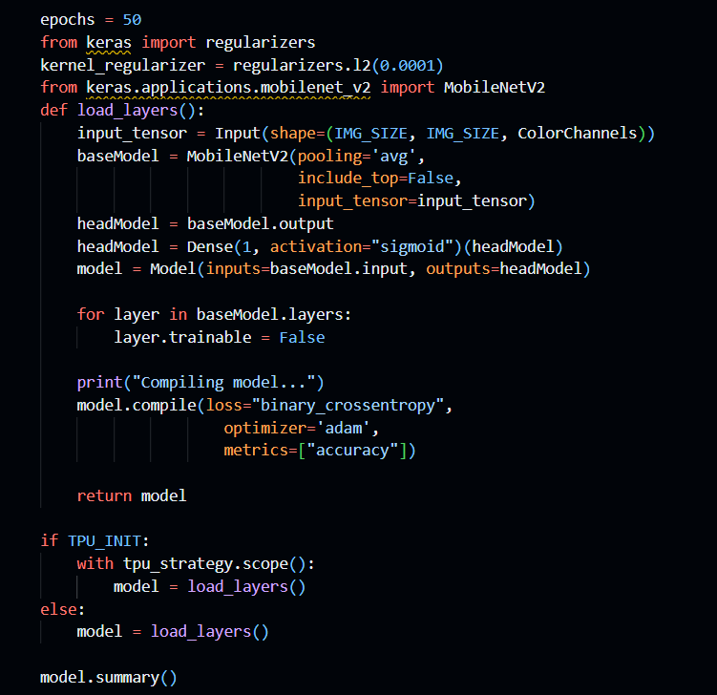
Program code (cont…)
Figure 5 : Code snippet to get summary of Model

Slide 21
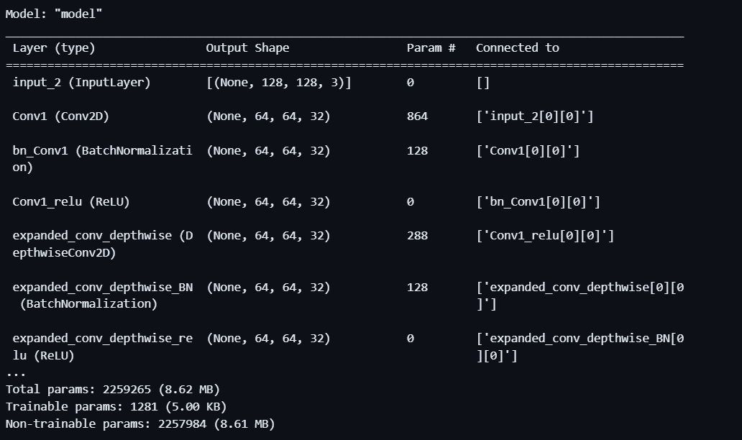
Program code (cont…)
Figure 5 : Different layers of model

Slide 22
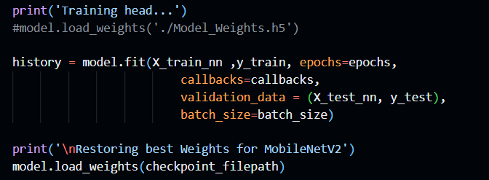
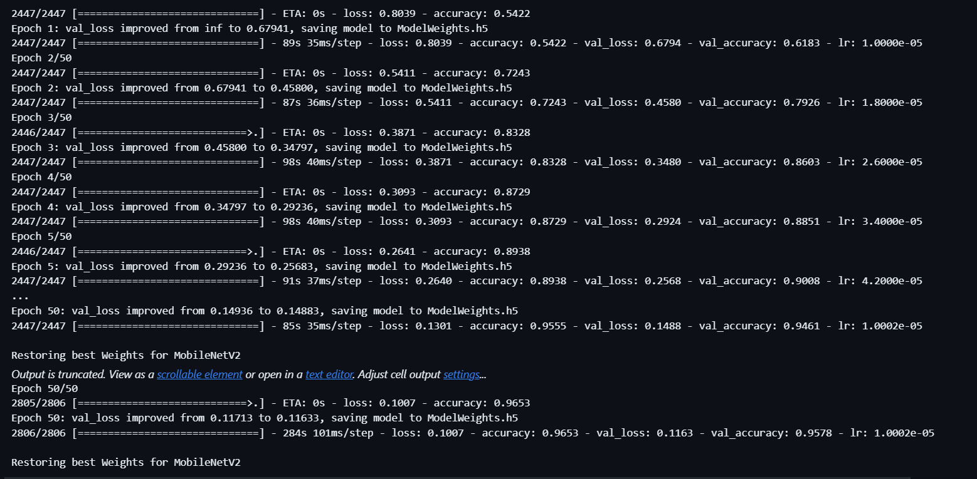
Program code (cont…)

Slide 23
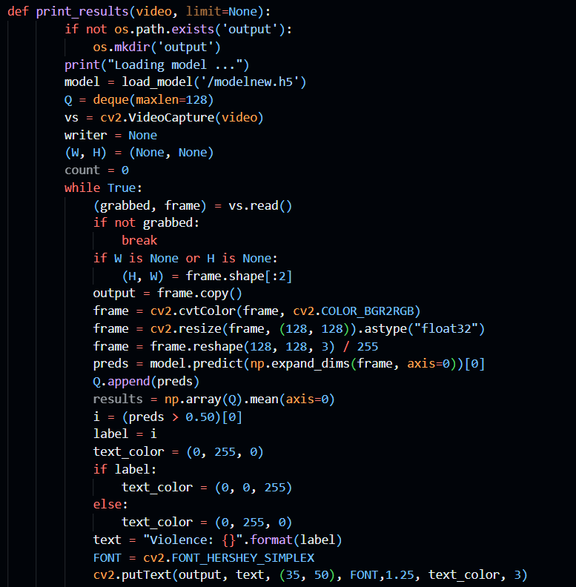
Program code (cont…)

Slide 24
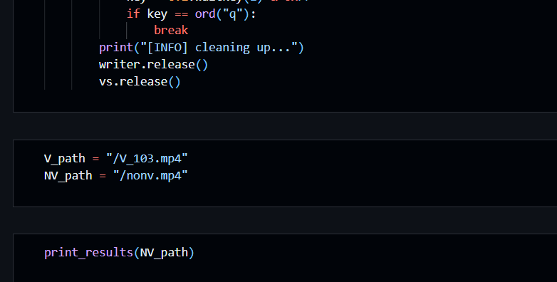
Program code (cont…)
Figure 6 : Violence Detection System Code

Slide 25
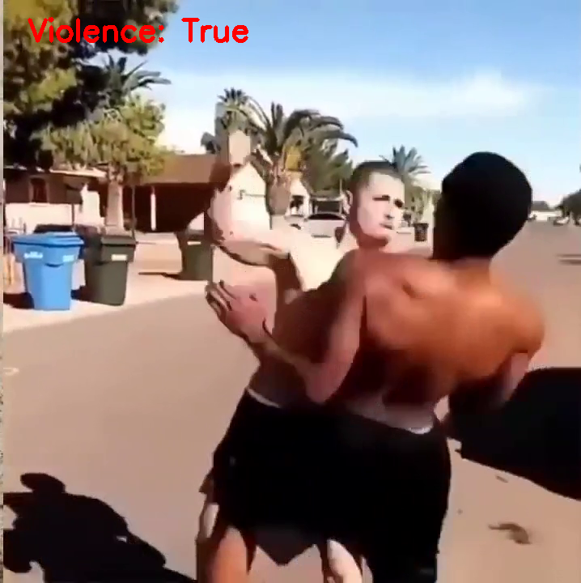
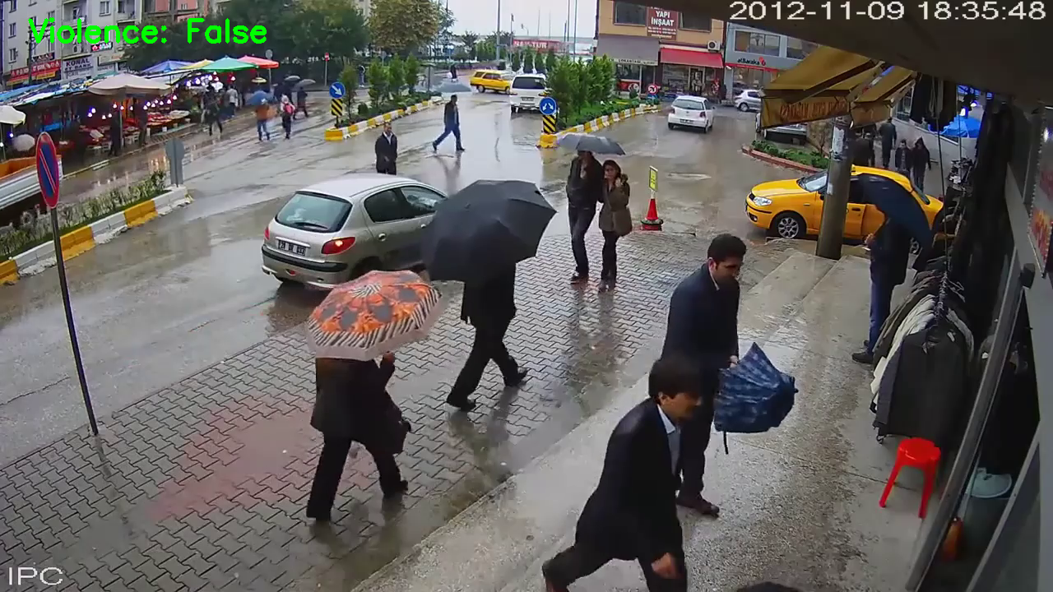
Output of Phase 1
Figure 7 : Violence Detection System Output

Slide 26
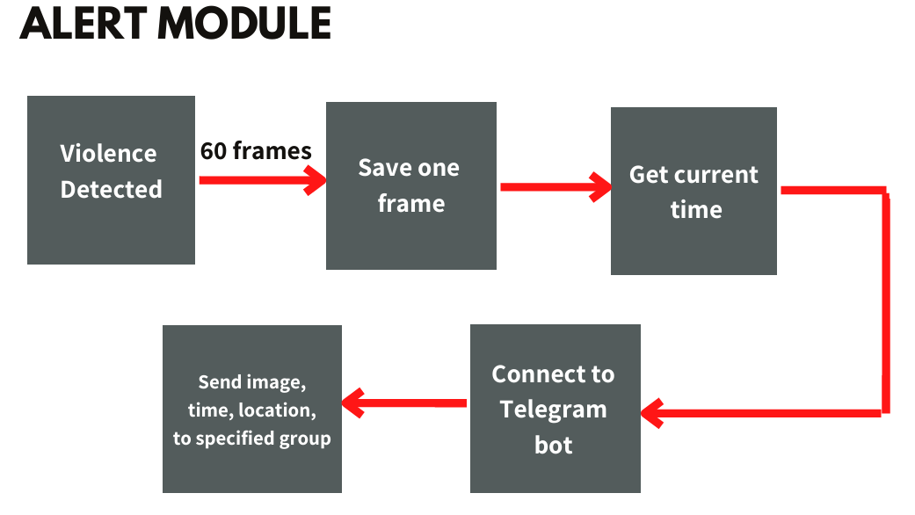
2nd Phase(Alert System)
Figure 8 : Methodology of Alert system

Slide 27
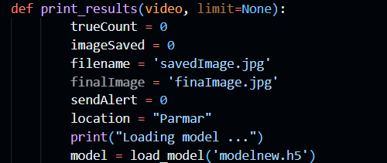
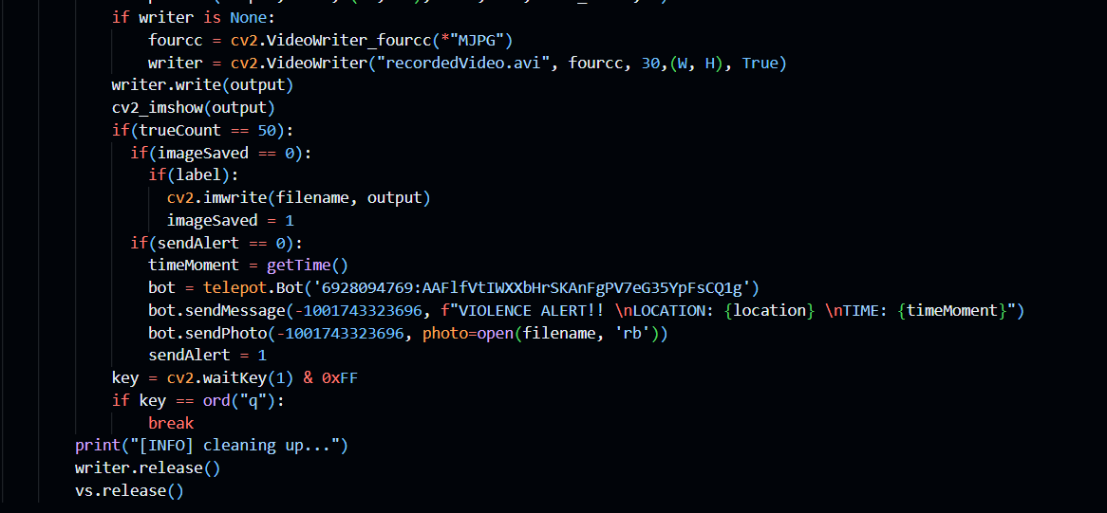
Program code
Figure 9 : Violence Alert System Code

Slide 28
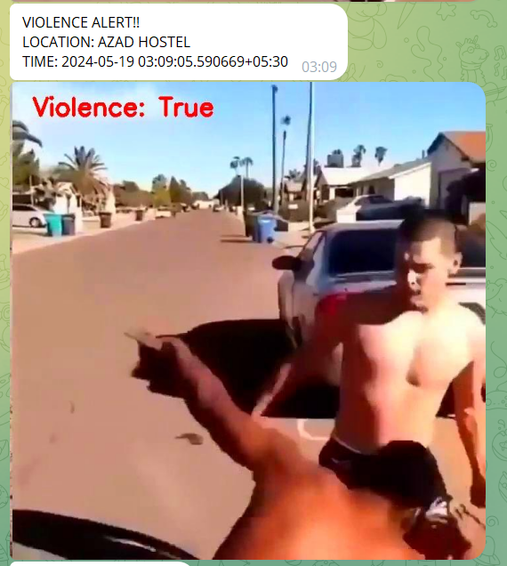
Output of Phase 2
Figure 10 : Violence Alert System Output

Slide 29
3rd Phase(Image Enhancement and Face Detection)
Image Enhancement:
⬡ Sharpness and color of obtained output frames is slightly improved
⬡ Uses inbuilt functions – Python PIL Library
⬡ Helps authorities in face detection & cross-checking
⬡ Output is obtained as image frames
Face Detection:
⬡ MTCNN and Pyplot are used
⬡ MTCNN consists of 3 stages of CNN for face detection and face alignment
⬡ Pyplot is a submodule of the matplot library

Slide 30
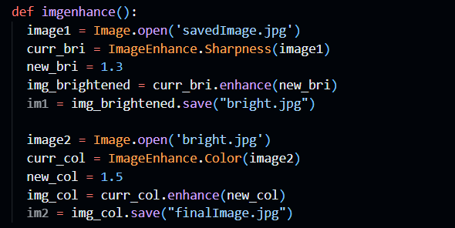
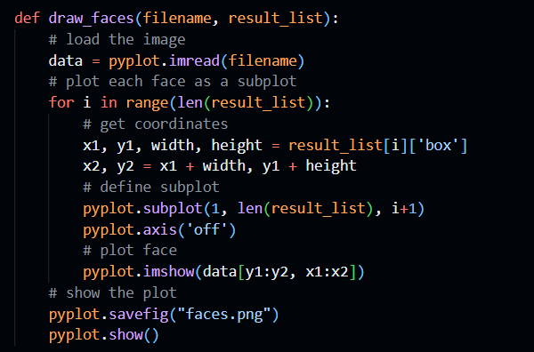
Program code
Figure 11 : Image Enhancement and Face Detection Code

Slide 31
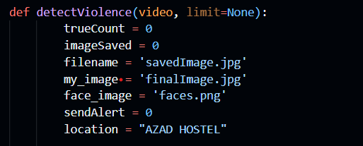
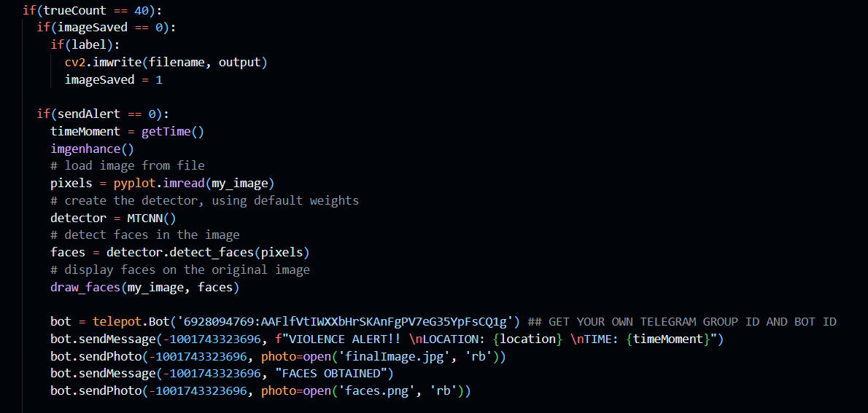
Program code (cont…)

Slide 32
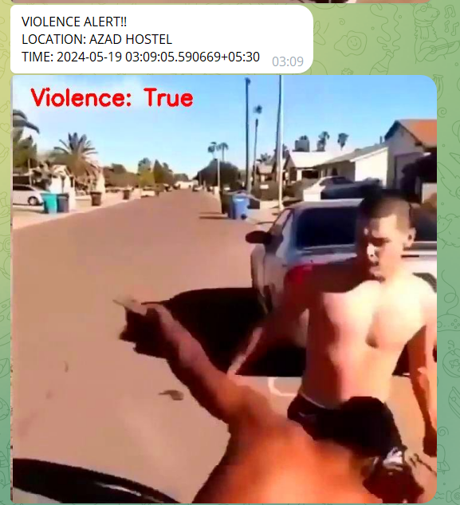
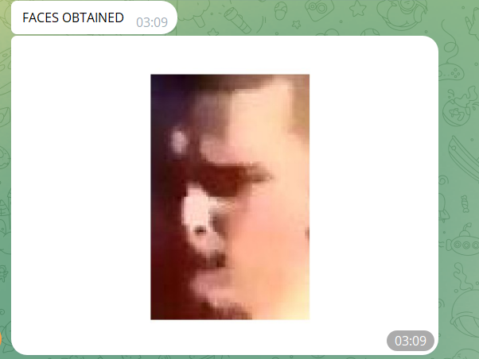
Output of Phase 3
Figure 12 : Image Enhancement and Face Detection Output

Slide 33
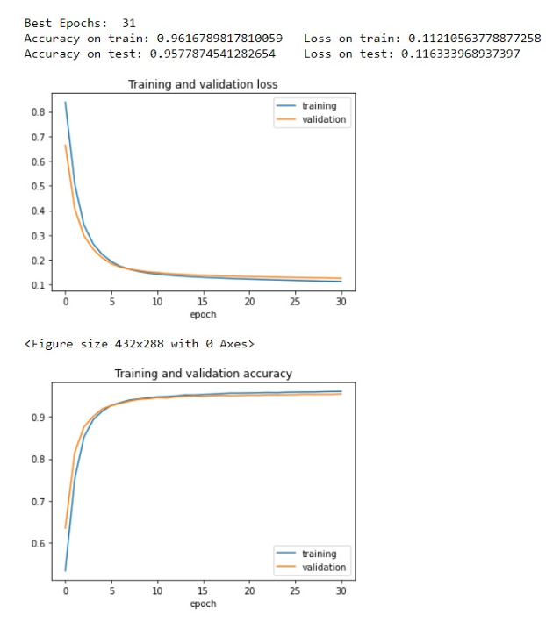
Results
Figure 13 : Accuracy and Error of the training set

Slide 34
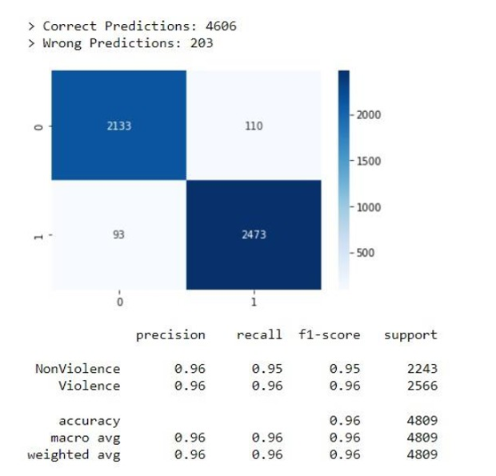
Results (cont…)
Figure 14 : Confusion matrix of the trained model

Slide 35
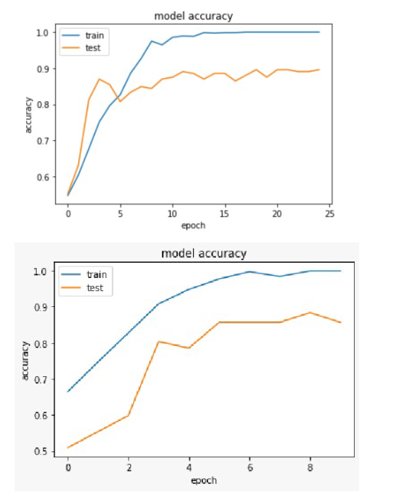
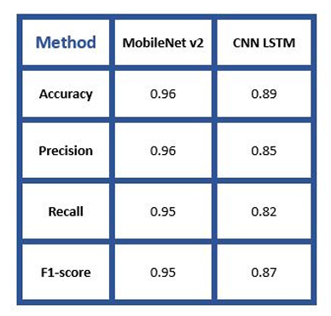
Results (cont…)
Figure 15 : Comparison of Training and Testing accuracy of MobileNet v2 and CNN- LSTM Models

Slide 36
Conclusion
Violence scene detection in real-time is a challenging problem due to the diverse content and large variations quality. In this research, we use the MobileNet v2 model to offer an innovative and efficient technique for identifying violent events in real-time surveillance footage. The proposed network has a good recognition accuracy in typical benchmark datasets, indicating that it can learn discriminative motion saliency maps successfully. It’s also computationally efficient, making it ideal for use in time-critical applications and low-end devices. Here, we had also shown the working of an Alert system that is integrated with the pretrained model. In comparison to other state-of the-art approaches, this methodology will give a far superior option.

Slide 37
Future Scope
This model could be upgraded to work in multiple cameras connected by a single network in a concurrent fashion. A short video of the violent activity could be incorporated along with the alert message

Slide 38
Work Contribution of Each Member
S. No. | Roll Number | Work Done | Contribution (%)
1. | 201139 | Literature review Data Analytics and data visualization | 33.33%
 |  | Model Designing & Hypertuning
2. | 201144 | Literature review Data Generation & code optimization | 33.33%
 |  | Model Designing & Hypertuning
3. | 201146 | Literature review Data generation and data visualization | 33.33%
 |  | Model Designing & Hypertuning

Slide 39
References
Khan SU, Haq IU, Rho S, Baik SW, Lee MY. Cover the Violence: A Novel Deep-Learning-Based Approach Towards Violence-Detection in Movies. Applied Sciences. 2019; 9(22):4963. https://sci-hub.se/10.3390/app9224963
2 Gopalakrishna, MT. (2016). Violence Detection in Surveillance Video-A survey.
International Journal of Latest Research in Engineering and Technology (IJLRET). NC3PS - 2016. 11-17. K. Elissa,
3 M. -S. Kang, R. -H. Park and H. -M. Park, "Efficient Spatio-Temporal Modeling Methods for Real-Time Violence Recognition," in IEEE Access, vol. 9, pp. 76270-76285, 2021, doi: 10.1109/ACCESS.2021.3083273.
https://sci-hub.se/10.1109/access.2021.3083273
4 Ullah FUM, Ullah A, Muhammad K, Haq IU, Baik SW. Violence Detection Using Spatiotemporal Features with 3D Convolutional Neural Network. Sensors (Basel). 2019 May 30;19(11):2472. doi: 10.3390/s19112472.
https://sci-hub.se/10.3390/s19112472
5 A. -M. R. Abdali and R. F. Al-Tuma, "Robust Real-Time Violence Detection in Video Using CNN And LSTM," 2019 2nd Scientific Conference of Computer Sciences (SCCS), 2019, pp. 104-108, doi: 10.1109/SCCS.2019.8852616.
https://sci-hub.se/10.1109/sccs.2019.8852616

Slide 40
References (cont…)
6 J. C. Vieira, A. Sartori, S. F. Stefenon, F. L. Perez, G. S. de Jesus and V. R. Q. Leithardt, "Low-Cost CNN for Automatic Violence Recognition on EmbeddedSystem," in IEEE Access, vol. 10, pp. 25190-25202, 2022, doi: 10.1109/ACCESS.2022.3155123.
https://ieeexplore.ieee.org/document/9722878
Sandler, Mark Howard, Andrew Zhu, Menglong Zhmoginov, Andrey Chen, Liang-Chieh. (2018). MobileNetV2: Inverted Residuals and Linear Bottlenecks. 4510-4520. 10.1109/CVPR.2018.00474.
https://sci-hub.se/10.1109/cvpr.2018.00474
8 J. Wang and Z. Xu, "Crowd anomaly detection for automated video surveillance,“ 6th International Conference on Imaging for Crime Prevention and Detection (ICDP-15), 2015, pp. 1-6, doi: 10.1049/ic.2015.0102.
https://sci-hub.se/10.1049/ic.2015.0102
9 P. Sernani, N. Falcionelli, S. Tomassini, P. Contardo and A. F. Dragoni, "Deep Learning for Automatic Violence Detection: Tests on the AIRTLab Dataset," in IEEE Access, vol. 9, pp. 160580-160595, 2021, doi: 10.1109/ACCESS.2021.3131315
download pdf
M. Ramzan et al., "A Review on State-of-the-Art Violence Detection Techniques," in IEEE Access, vol. 7, pp. 107560-107575, 2019, doi: 10.1109/ACCESS.2019.2932114
https://sci-hub.se/10.1109/access.2019.2932114

Slide 41
Thank You.

